Slide 1
Introduction to Information Systems and Programming
Objects and Classes
[some materials adopted from Liang, Introduction to Java Programming]

Slide 2
Object-Oriented (OO) Programming
OO Programming: programming using objects
vs. procedural programming (step-by-step statements, procedure call)
Program: interaction between objects
Abstraction, encapsulation, inheritance, polymorphism
Enable development of large-scale software
Object represents an entity in the real world
A student, a desk, a circle
An object has a unique identity, state, behaviors
State / data fields / properties / attributes
Behavior / methods / action

Slide 3
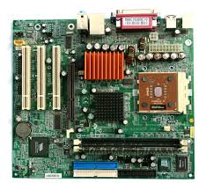

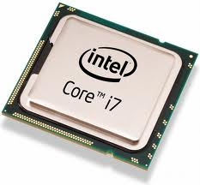
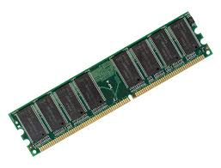
Object-Oriented (OO) problem solving (abstraction, encapsulation, etc) is fundamental in engineering
Assemble your own computer:
-motherboard
-cpu
-RAM
-harddisk
-power supply
-keyboard
-monitor
…
-Put the components together, it would work
-No need to worry about the details of components
-Details of the components are encapsulated
-Need to ensure correct interface

Slide 4
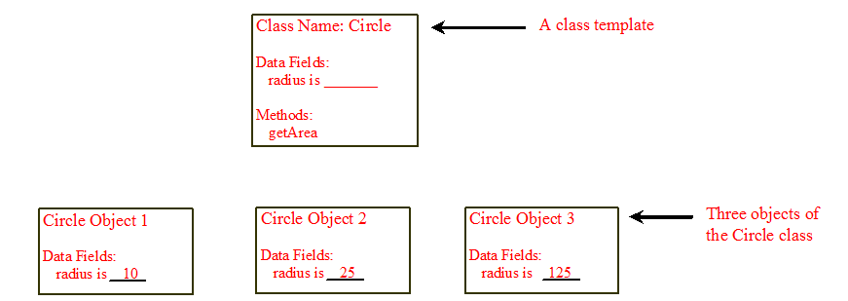
Objects
An object has both state and behavior

Slide 5
Classes
Objects of the same type are defined by Class
A class is a template / contract that defines the object’s data fields and methods
An object is an instance of a class
Java variables: data fields
Java methods: behaviors
Constructors: special type of methods, invoked to construct objects from classes

Slide 6
Classes

Slide 7
Constructors
Special kind of methods that are invoked to create a new object (create an instance, or instantiation)
Circle() {
}
Circle(double newRadius) {
radius = newRadius;
}
// method overloading:
// same method name
// different argument list

Slide 8
Constructors
No-arg constructor: constructor without parameter
Constructor must have the same name as the class itself
No return type, not even void
Invoked with the new operator, play the role of initializing objects

Slide 9
Creating objects using constructors / instantiation
new ClassName();
Example:
new Circle();
new Circle(5.0);

Slide 10
Default Constructor
A class may be defined without constructors. In this case, a no-arg constructor with an empty body is implicitly declared in the class. This constructor, called a default constructor, is provided automatically only if no constructors are explicitly defined in the class.

Slide 11
Object Reference Variables
To reference an object, assign the object to a reference variable.
To declare a reference variable, use the syntax:
ClassName objectRefVar;
Example:
Circle myCircle;

Slide 12
Object Reference Variables
ClassName objectRefVar = new ClassName();
Example:
Circle myCircle = new Circle();

Slide 13
Access object
Referencing the object’s data:
objectRefVar.data
e.g., myCircle.radius
Invoking the object’s method:
objectRefVar.methodName(arguments)
e.g., myCircle.getArea()

Slide 14
Example
Circle myCircle = new Circle(5.0);
Declaration: associates a variable with an object type
Instantiation: new operator allocates memory, returns reference to the object memory, invokes constructor
Initialization: by constructor

Slide 15
Instance Method
getArea() is an instance method (without static keyword)
Must be invoked from an object
E.g., myCircle.getArea()

Slide 16
Activity
Develop bank account class Account in Java (shorter version of cohort problem)
Attribute int id for the account
Attribute double balance for the account
A method named withdraw that withdraws a specified amount from the account
A method named deposit that deposits a specified amount to the account
Write a TestAccount client class to test the Account class (use withdraw / deposit methods, check balance)

Slide 17
Activity
What is wrong in the following code?
class Test {
public static void main(String[] args) {
A a = new A();
a.print();
}
}
class A {
String s;
A(String s) {
this.s = s;
}
public void print() {
System.out.print(s);
}
}

Slide 18
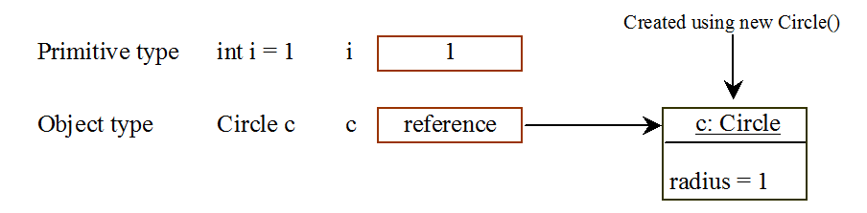
Differences between variables of primitive data types and object types

Slide 19
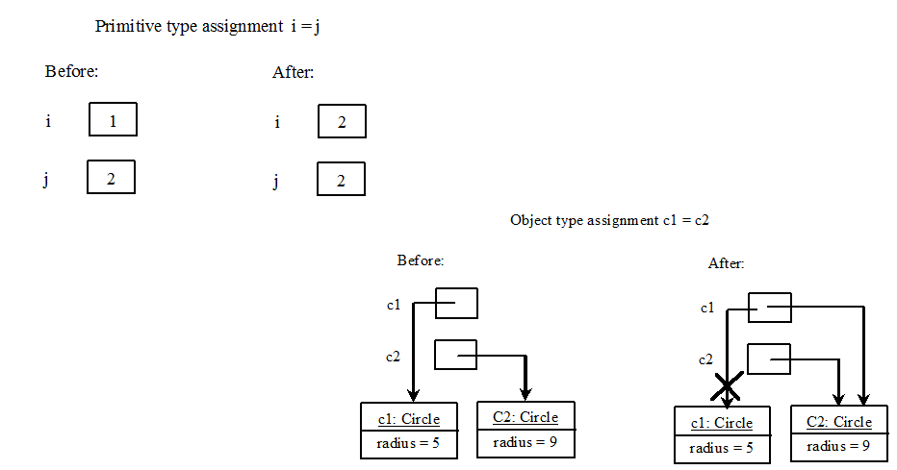
Differences between variables of primitive data types and object types
Garbage collected automatically by JVM
(assigning reference variable to null helps garbage collection)
Notes:
Assign null to a reference variable for the object explicitly

Slide 20
Instance variables and methods
Instance variables belong to a specific instance
Instance methods are invoked by an instance of the class

Slide 21
Static variables, methods
Static variables are shared by all the instances of the class
Are not tied to a specific object
Use the static modifier
Static method can be called without creating an instance of the class

Slide 22
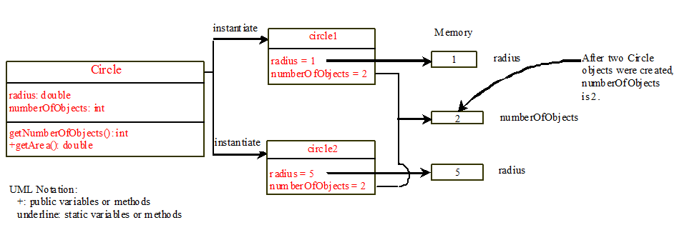
Static variables, methods

Slide 23
Activity: can an instance method invoke another instance method, access a static data field? Make educational guess
Yes / no
An instance method
An instance data field
A static method
A static data field
Yes / no
An instance method
Yes / no
Yes / no
Yes / no
An instance method
An instance data field
A static method
A static data field
Yes / no
A static method
Yes / no
Yes / no

Slide 24
Activity
Do all Java Classes have constructor?

Slide 25
Visibility modifiers: public, private
By default, the class, variable or method can be accessed by any class in the same package (Package: organizes Java classes into namespaces)
public: visible to any class in any package
default: package private, visible only to classes in the same package
private: visible only by the declaring class

Slide 26
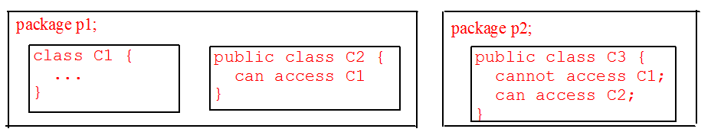
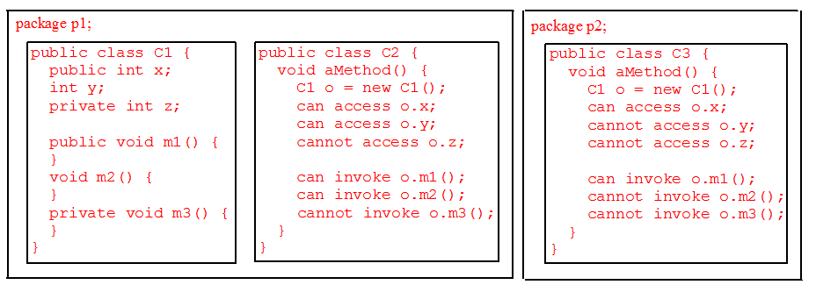
The private modifier restricts access to within a class, the default modifier restricts access to within a package, and the public modifier enables unrestricted access.

Slide 27
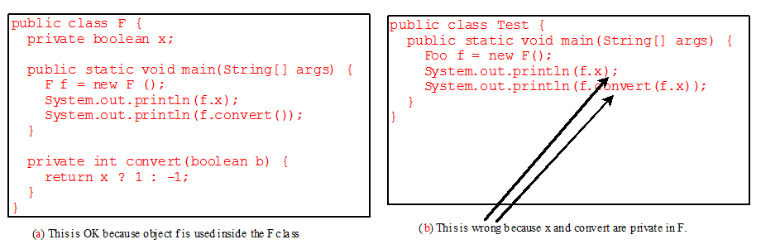
Visibility modifiers: public, private
Private members can be used within their own classes

Slide 28
Why put data fields private
To protect data
client can tamper the classes / objects
To make class easy to maintain
impose class constraints / invariants

Slide 29
Data Field Encapsulation
Keep attributes private, if possible
Use get method (getter / accessor) to return the values of attributes, e.g., double getRadius()
Use set method (setter / mutator) to update attributes, e.g., void setRadius(double radius)()
Design principles:
Minimize the accessibility of classes and members
In public classes, use accessor methods, not public attributes

Slide 30
Passing objects to methods
Java: only pass-by-value
Primitive type: value is passed
Reference type: value (reference to an object) is passed

Slide 31
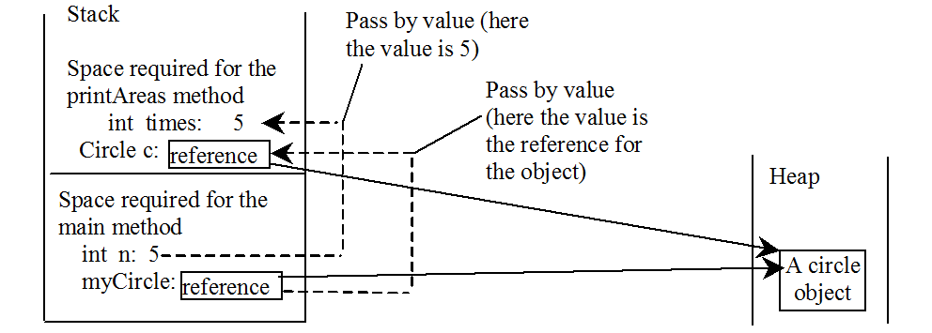
Passing objects to methods
public static void printAreas(Circle c, int times) {
times = 0;
c.setRadius(100.0);
}
int n=5;
Circle myCircle = new Circle (2.0);
printAreas(myCircle, n);

Slide 32
Activity (Solution)
What is wrong in the following code?
class Test {
public static void main(String[] args) {
A a = new A();
a.print();
}
}
class A {
String s;
A(String s) {
this.s = s;
}
public void print() {
System.out.print(s);
}
}
A: Class A does not have a no-arg constructor. So you cannot use new A().

Slide 33
Activity: can an instance method invoke another instance method, access a static data field? Make educational guess (solution)
Yes / no
An instance method
An instance data field
A static method
A static data field
Yes / no
An instance method
Yes / no
Yes / no
Yes / no
An instance method
An instance data field
A static method
A static data field
Yes / no
A static method
Yes / no
Yes / no

Slide 34
Activity (solution)
Do all Java Classes have constructor?
Yes. If no explicit constructor, an no-arg constructor is implicitly defined, therefore, at least one constructor
This is true also for abstract class
But not true for interface. Although it is convenient to think of interface as 100% abstract class, still an interface is not a class (e.g., no root interface, not inherited from java.lang.Object)

